Slide 1





Quick review for last class
Summary1:
The more accurate sequence in the independent variable transformation
Given a signal x(t) , to determine signal x(at − b) .
Step1:
apply the time shift:
x(t) → x(t − b)
Step2:
perform the time scaling: x(t − b) → x( a t − b)
Step3: reversal if a < 0:
x( a t − b) → x(− a t − b)

Slide 2
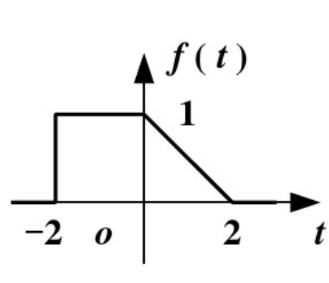


Plot

Slide 3
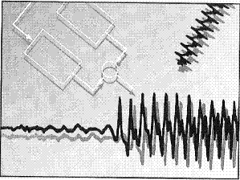
Signals and Systems
(by Alan V. Oppenheim etc. 2003)
Chapter 1.3.1 Exponential & Sinusoidal Signals
All the pictures and images used is in these lecture notes
are adopted from “Signals and Systems” by Alan V. Oppenheim，etc.

Slide 4
Outline of Chapter 1
Introduction
Continuous-Time & Discrete-Time Signals
Basic Transformations of Signals
Basic Transformations of Dependent Variables
Basic Transformations of Independent Variables
Exponential & Sinusoidal Signals
The Unit Impulse & Unit Step Functions
Continuous-Time & Discrete-Time Systems
Basic System Properties

Slide 5

1.3.1 Exponential & Sinusoidal Signals
— CT Complex Exponential Signals
Why introduce?
Occur frequently
Serve as building blocks to construct many other signals
CT Complex Exponential Signals:
x(t) = Ce^{at}
a = r + jω₀
C = C e ^{jθ}
Real Exponential Signals: C and a are real
Periodic Complex Exponential: C is real, a is purely imaginary
C.General Complex Exponential:
If a and C are both in general complex

Slide 6
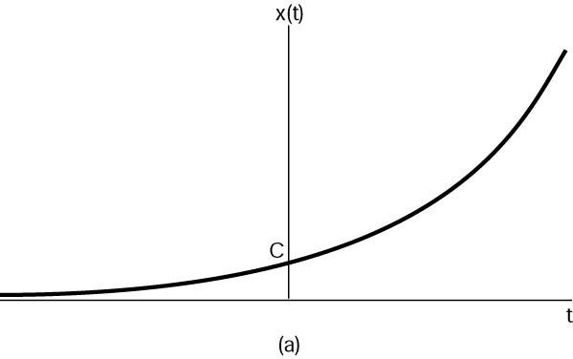
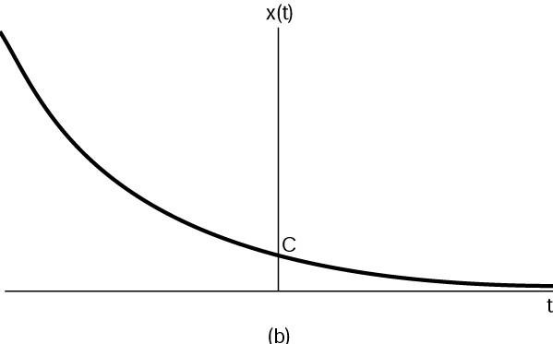
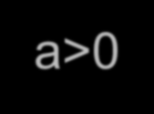



1.3.1 Exponential & Sinusoidal Signals
— CT Complex Exponential
A.Real Exponential Signals: C and a are real
x(t) = Ce^{at}
a>0
a<0
Growing exponential
Decaying exponential
Figure 1.19 Continuous-time real exponential

Slide 7
Complex number
Expressions
Coordinate
Example: x=e^jθ

Slide 8
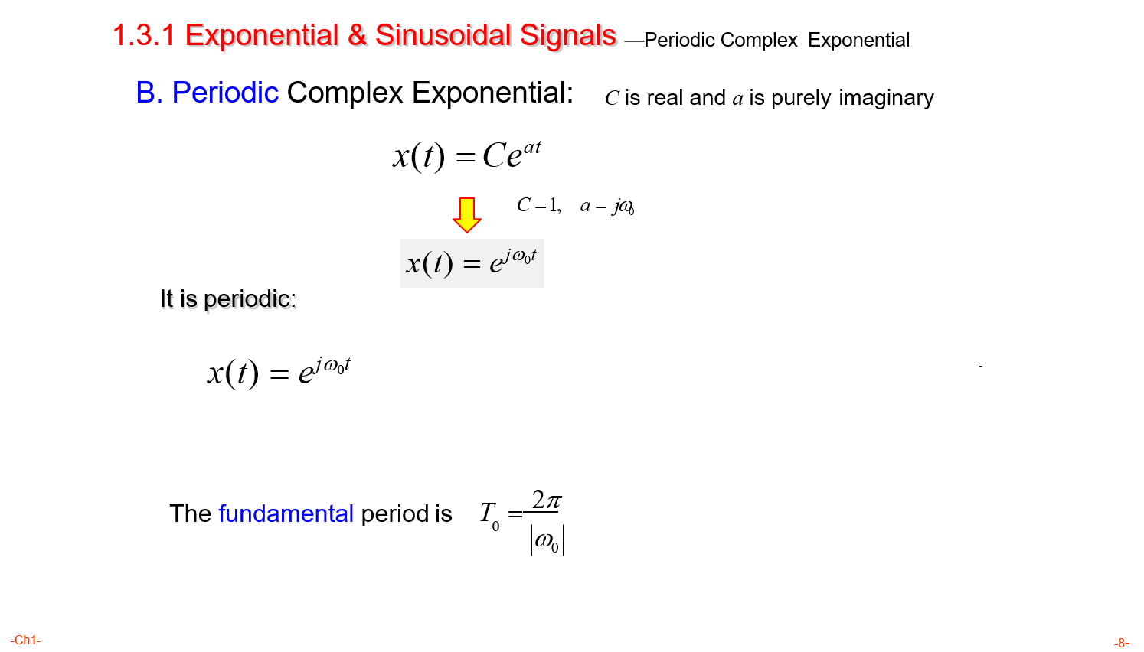

Slide 9
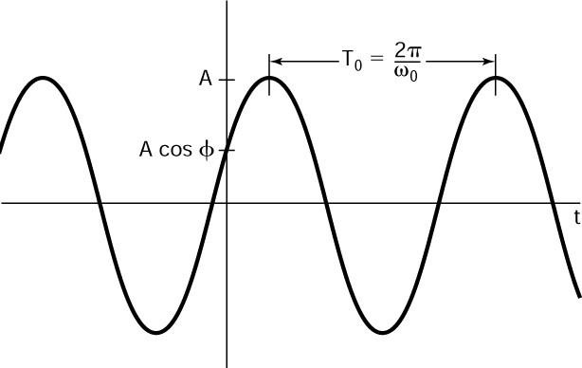
1.3.1 Exponential & Sinusoidal Signals
—CT sinusoidal signal
CT sinusoidal signals:
θ:Initial phase
x(t) = Acos(ω₀t +θ )
A :Amplitude
Physical Frequency
Angular Frequency/Speed Or
Circular Frequency/Speed
ω₀ = 2πf₀
_{T =} 2π ₌ 1
0
ω f
Elementary Period
0 0
T₀ : (sec)
ω₀ : (rad / sec)
f₀ : (1 sec, Hz)
t = ^{θ}
ω₀

Slide 10
1.3.1 Exponential & Sinusoidal Signals—Euler’s relations
Euler’s relations
Im
e ^{jω0t} = cosωt + j sinωt
0 0
j
e^{− jω0t} = cosωt − j sinωt
0 0
sinω₀t
_{e} jω₀t
0
cosω₀t
1
Re
1
2
jωt _{+ e}− jωt ₎
cosωt =
(e
0
0
0
1
jωt _{− e}− jωt ₎
sinωt =
2 j
(e
0
0
0

Slide 11


1.3.1 Exponential & Sinusoidal Signals —Complex periodic exponential and sinusoidal signals
Energy & Power:
T +T₀
∫
T
T +T₀
Periodic complex exponential and sinusoidal signals are both power signals
E =
e ^{jω0t 2} dt =
∫
T
1⋅ dt = T
period
0
1
P =
E = 1
period
(T + T ) − T
period
0
As the upper limit of integrand is increased as
T + 2T₀ ,T + 3T₀ ,
,T + ∞T₀
^{E}period
→∞
However, always P_{period} = 1
1
T
∫
−T
_{e} jω₀t
2
Thus,
P = lim
⋅
dt = 1
∞
T →∞ _{2T}

Slide 12


1.3.1 Exponential & Sinusoidal Signals—Harmonically Related Complex Exponentials
Harmonically related ones:
_{e} j −3ω₀t _{, e} j −2ω₀t _{, e} j −1ω₀t _{, e} j 0ω₀t _{, e} j1ω₀t _{, e} j 2ω₀t _{, e} j 3ω₀t
x (t) = e ^{jkω0t} for k = 0, ±1, ±2,
k
Orthogonal to each other
k = 0：x_{k} (t) is a constant
k = ±1：x_{k} (t) is the first harmonic
k = ±2：x_{k} (t) is the second harmonic
Fundamental frequency: k ω₀
For the kth harmonic:
2π T
2π
Fundamental period = ⁰ , where T =
k ω k
0
ω
0
0

Slide 13
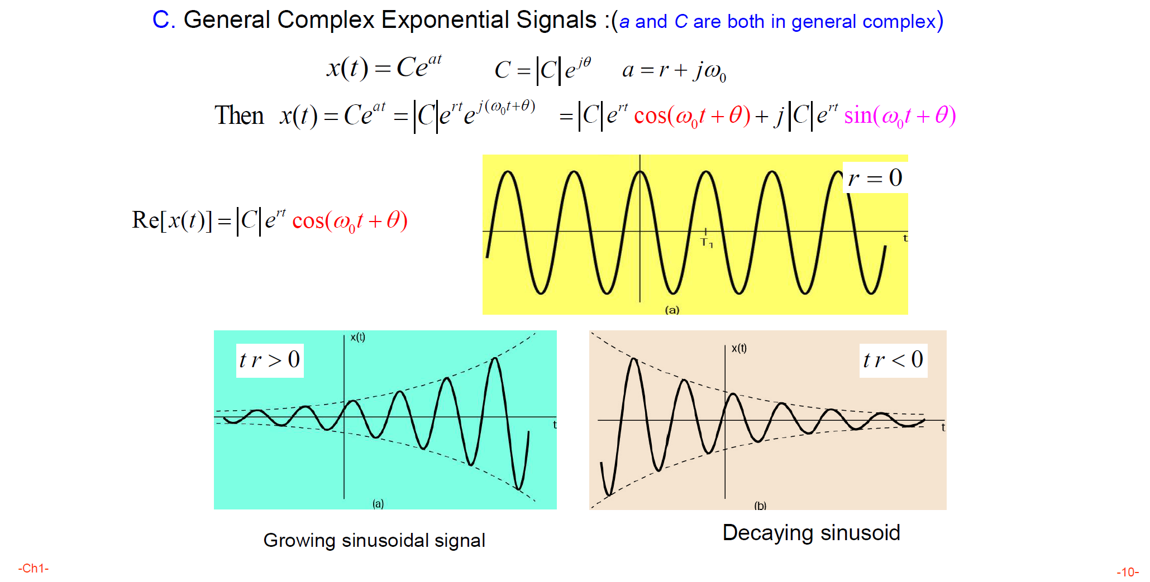
1.3.1 Exponential & Sinusoidal Signals —General Complex Exponential Signals

Slide 14

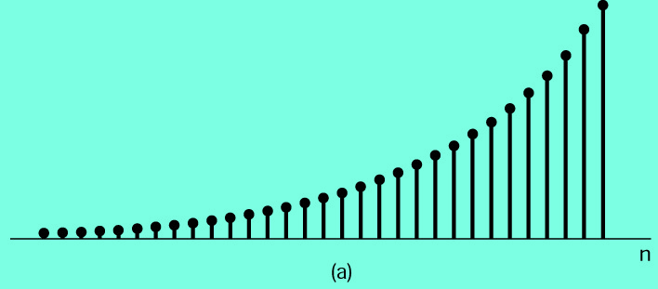
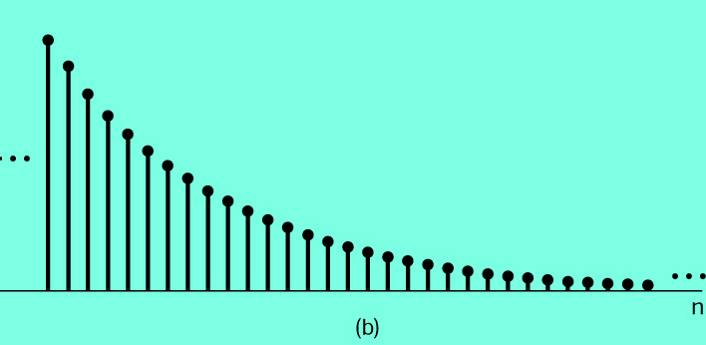
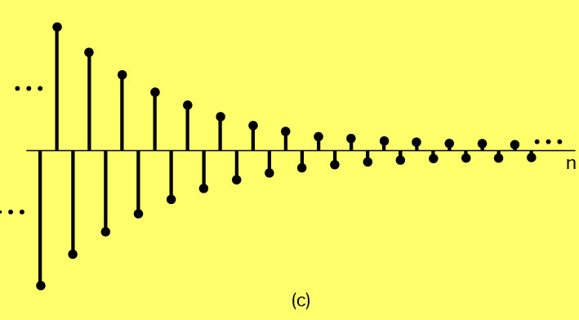
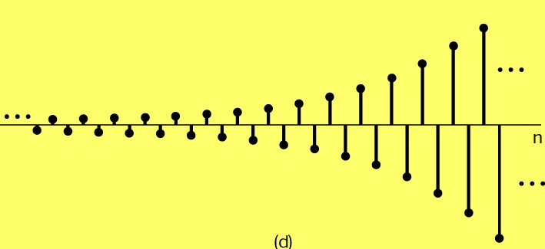
1.3.2 Exponential & Sinusoidal Signals—DT Complex Exponential & Sinusoidal Signals (sequences)
DT Complex Exponential & Sinusoidal Signals (sequences):
x [n] = C(e^{β})^{n}
α= e^{β}
x(t) = Ce^{at}
x(nT ) = Ce^{aTsn}
s
aT_{s} = β
x[n]= Cα^{n}
C ,α
Maybe complex or real
A. Real Exponential Signals:
C ,α both are real
α> 1
0 <α< 1
−1 <α< 0
α< −1

Slide 15





1.3.2 Exponential & Sinusoidal Signals
— Periodic complex exponential signals(sequence)
B. Periodic complex exponential signals(sequence)
C = 1, a = e ^{jΩ0}
jωt
e = cosωt + j sinωt
0
0 0
nT_{s} → t
Analog angle speed ω: rad / s
e ^{jωT n} = cos(ωT n) + j sin(ωT n)
0 s
0 s 0 s
Digital angle speed
Ω : rad
ω₀T_{s} =Ω₀
e ^{jΩ0n} = cos(Ω n) + j sin(Ω n)
0 0
Complex periodic exponential and sinusoidal sequence are both power signals
Infinite energy, finite average power with 1.

Slide 16

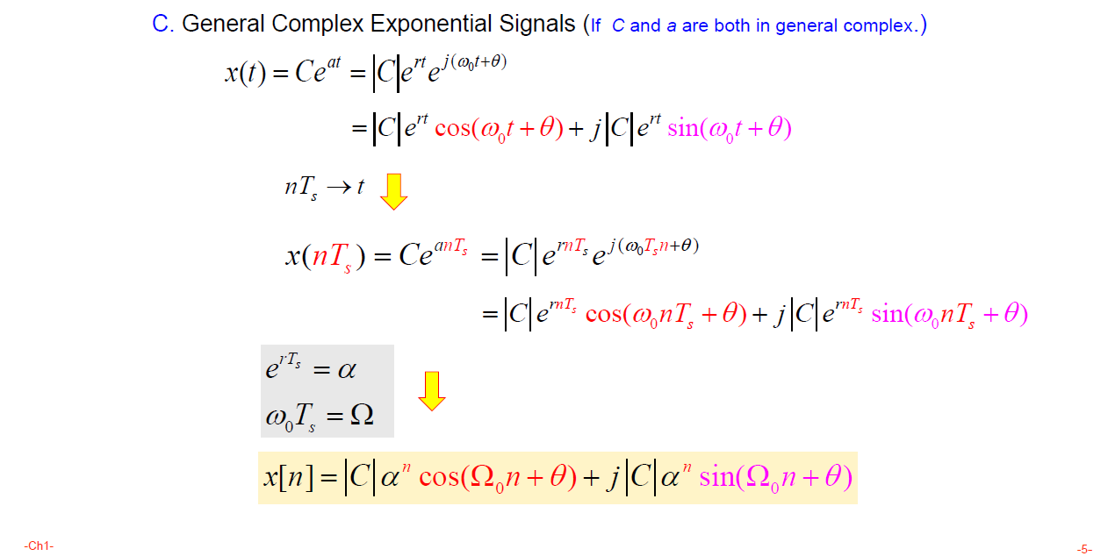
1.3.2 Exponential & Sinusoidal Signals
— General complex exponential Signals(sequence)

Slide 17

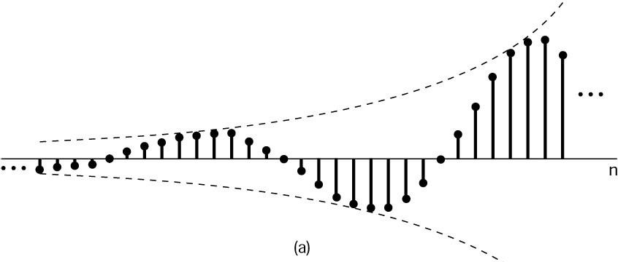
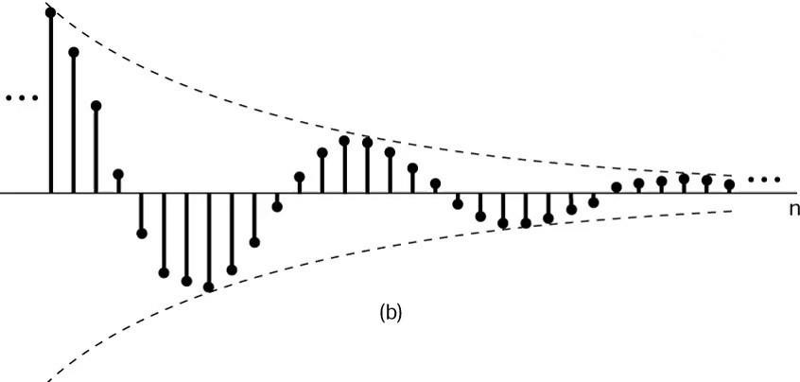
1.3.2 Exponential & Sinusoidal Signals
— General complex exponential Signals(sequence)
Re[x[n]] = C α^{n} cos(Ω n +θ)
0
α > 1
α < 1
(a) Growing sinusoidal sequence
(b) Decaying sinusoidal sequence
Figure 1.26 Sinusoidal sequence

Slide 18

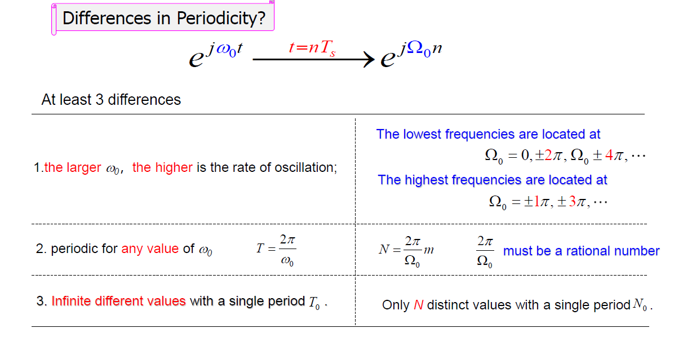
1.3.3 Exponential & Sinusoidal Signals
— Periodicity Properties of CT&DT Complex Exponentials

Slide 19
1.3.3 Exponential & Sinusoidal Signals
— Periodicity Properties of CT&DT Complex Exponentials
Differences 1:
cos(0 ⋅πt)
cos(¹πt) 8
cos( ¹πt) 4
cos( ¹πt) 2
cos(1⋅πt)
cos( ⁵ ⋅πt) 4

Slide 20
1.3.3 Exponential & Sinusoidal Signals
— Periodicity Properties of CT&DT Complex Exponentials
cos( ⁶ ⋅πt)
cos( ⁷ ⋅πt)
cos(2 ⋅πt)
4
4
cos( ⁹ ⋅πt) 4
cos(3⋅πt)
cos(4 ⋅πt)

Slide 21
1.3.3 Exponential & Sinusoidal Signals
— Periodicity Properties of CT&DT Complex Exponentials
cos(0πn)
cos(¹πn)
cos( ¹πn)
Differences 1:
8
4
cos( ¹πn)
cos(1πn)
cos( ³πn)
2
2
14
15
cos( πn) 8
cos( πn) 8
cos(2πn)

Slide 22








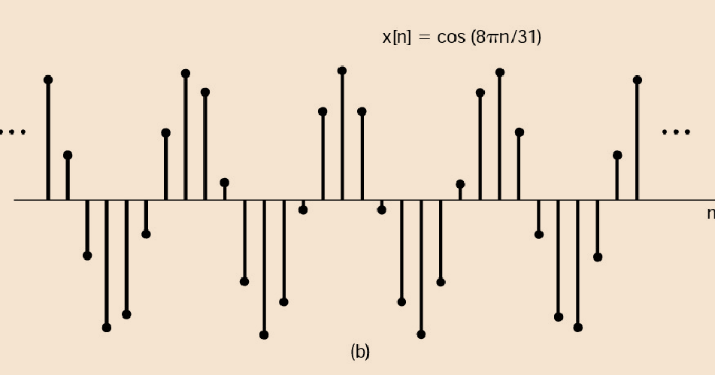

1.3.3 Exponential & Sinusoidal Signals —Periodicity Properties of CT&DT Complex Exponentials
Example 1.1
x[n] = cos(^{8π}n)
N and m do not have on factors in common
31
jΩ n jΩ
（n +N )
jΩ n jΩ N
e =e
= e e
0
0
0
0
8π
Ω₀ = ₃₁
2π 31
N = _{Ω} m = ₄ m
_{e} jΩ₀ N
0
= 1
let m = 4
N = 31
Ω₀ N = 2πm
Period is N=31
2π
_{Ω0} must be
a rational number
N = ^{2π}m
Ω₀
-8-
-Ch1-

Slide 23

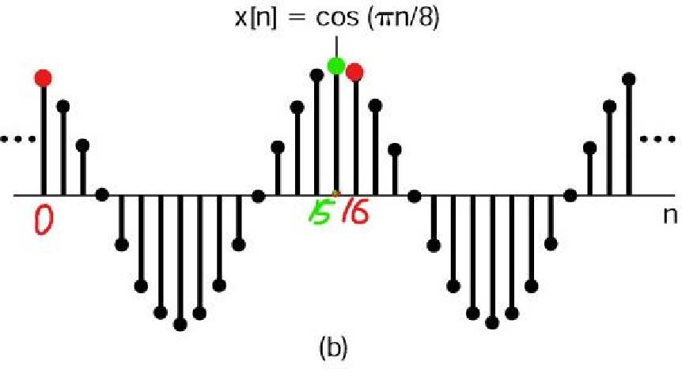




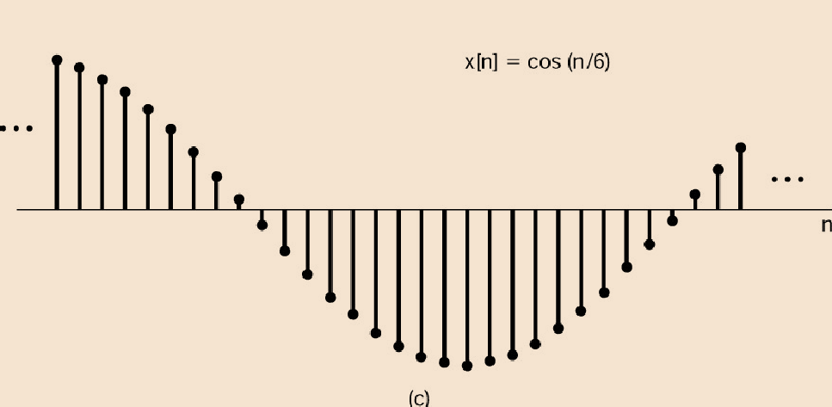

x[n] = cos(nπ 8)
1.3.3 Exponential & Sinusoidal Signals —Periodicity Properties of CT&DT Complex Exponentials
Example 1.2
Counted from 0
Ω = ^{π}
0
8
2π ₌
rational
16
Ω
0
Period is N=16
Example 1.3
x[n] = cos(n 6)
Ω = ¹
0
6
= 12π
Non-rational
2π
Ω
0
Aperiodic
-23-

